Slide 1

ECE 281 Lesson 17
Maj Jeffrey Falkinburg USAFA/DFEC
Room 2E46E 333-9193
1

Slide 2
Lesson 17 Outline
Do Time Logs!
Do Feedback!
Homework #2 (LSN 15/16 Worksheet) – Due Now!
Lab #2 Prelab Due LSN 19!
VHDL – Sequential Logic
Process

Slide 3
VHDL – What we have talked about
Entity – Defines inputs and outputs of box
Architecture – Describes what is inside the box
Two Types of Architecture:
Behavioral – Describes what module does in terms of the relationships between inputs and outputs
Structural – Describes what a module does in terms of how it is composed of simpler modules

Slide 4
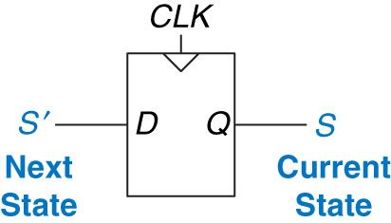
Flip-Flops and Finite State Machines
Flip Flops Create Memory
On the Clock Edge!
Figure 3.20 Flip-flop current state and next state
Copyright © 2013 Elsevier Inc. All rights reserved.

Slide 5
Finite State Machines – Design/Analysis
State Machines:
0) Description
1) State Transition Diagram
2) State Transition Table & Output Table
3) Next State and Output State Equations
4) Schematic
Design
Analysis
Copyright © 2013 Elsevier Inc. All rights reserved.

Slide 6
Finite State Machines - Moore vs Mealy Machine
Moore Machine – outputs depend only on current state of the machine.
Mealy Machine – outputs depend on both the current state and current inputs of the machine.
Clock
Next
State
Current
State
Inputs
M
Combinational Logic or
Next State Logic
K
Flip Flops
K
Output Logic
N
Outputs
Clock
Next
State
Current
State
Inputs
M
Combinational Logic or
Next State Logic
K
Flip Flops
K
Output Logic
N
Outputs

Slide 7
Process
Process – Collection of sequential statements that execute in parallel with other concurrent statements and other processes
Always running or suspended
Creates a “box” that listens for signals (wires)
When the signal changes the box is told to run
*** Processes are scary!
Add memory
Make circuit hard to visualized
➔ If you want a Flip-Flop you need a process

Slide 8
Generic Example Process
process(signal name, signal name, …., signal name)
Type declarations
Variable declarations
Constant declarations
Functions declarations
Procedure definitions
begin
sequential statement
…
sequential statement
end process;

Slide 9
Specific Example Process
Specific Example Process:
process(A, B)
begin
Y <= A and B;
end process;
What do we get?

Slide 10
No Process
What if we have assignments not in a process:
Y <= A or C;
Y <= A and B;
Y <= C and D;
What do we get?

Slide 11
Make a Process
So we make a process:
process( )
begin
Y <= A or C;
Y <= A and B;
Y <= C and D;
end process;
What do we get?
A, B, C, D
Things are scheduled
Rest of stuff is ignored
Y is never assigned the first two values
Schedule is overwritten

Slide 12
Rules for Processes
Rules for Processes:
Think before using variables (don’t use them if you can help it)
Avoid “innovative” use of language constructs
*Avoid overriding a signal in a process (don’t assign a value twice)
*Only use processes for sequential circuits
* Indicates a rule for this class only

Slide 13
If Statements
If Statements
if boolean expression then
sequential statement
elsif boolean expression then
sequential statement
…
elsif boolean expression then
sequential statement
elsif executed only if boolean
expression true and previous
boolean expressions were false

Slide 14
Flip-Flop Example
Flip-Flop Example
library IEEE;
use IEEE.STD_LOGIC_1164.ALL;
entity Flip_Flop is
Port ( clk, D : in STD_LOGIC;
Q : out STD_LOGIC);
end Flip_Flop;
architecture Behavioral of Flip_Flop is
begin
process(clk)
begin
if (rising_edge(clk)) then
Q <= D;
end if;
end process;
end Behavioral;
Note: Do not use
*** clk’event and clk = ‘1’
Only use rising_edge(clk)
➔ can only use if inside a process
Build stuff
How do we make a Latch:
if (clk = '0') then
Q <= D;
end if;
Runs when clk changes
Only when 0→1
➔ Memory

Slide 15
Processes
Process may not declare signals, but can use variables
Keeps track of state within a process and is not visible outside of process (i.e. local variable)
Assign values based on a Blocking Statement
:= instead of <=
Blocking Statement
Evaluated in order in which they appear, like in code
NonBlocking Assignments are evaluated concurrently
Signals updated afterwards

Slide 16
Blocking Statement Example
process(A, B)
variable tmp : STD_LOGIC;
begin
tmp := '0';
tmp := tmp or A;
tmp := tmp or B;
Y <= tmp;
end process;

Slide 17
NonBlocking Statement Example
process(A, B)
variable tmp : STD_LOGIC;
begin
tmp <= '0';
tmp <= tmp or A;
tmp <= tmp or B;
Y <= tmp;
end process;

Slide 18
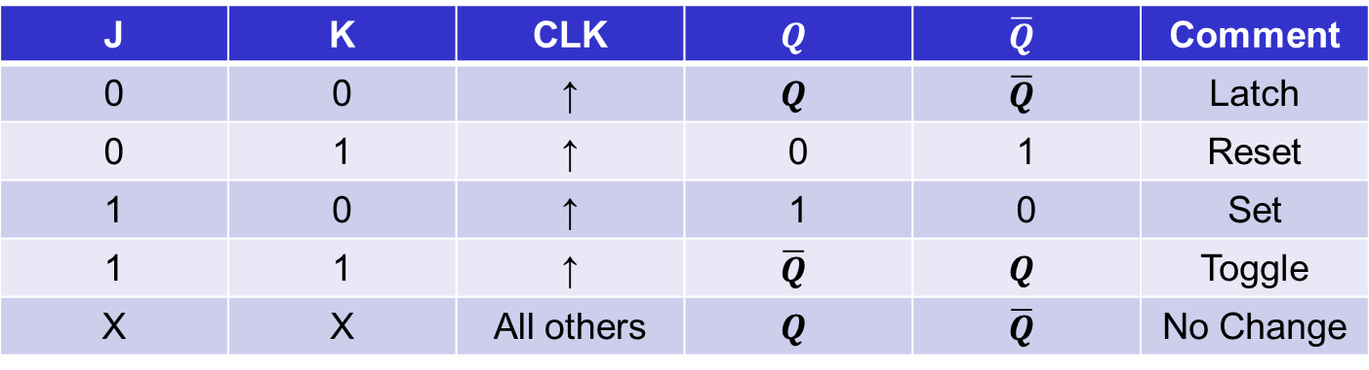
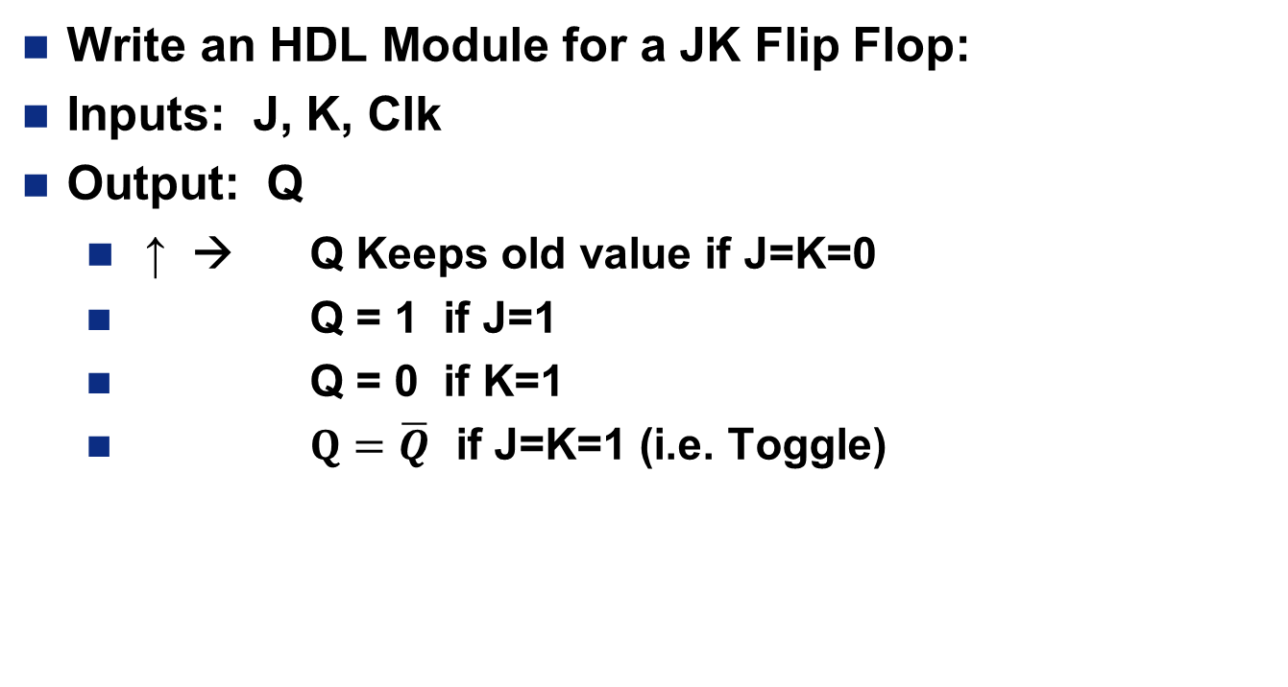
In Class Exercise #1:
Write an HDL Module for a JK Flip Flop:
Inputs: J, K, Clk
Output: Q
↑ → Q Keeps old value if J=K=0
Q = 1 if J=1
Q = 0 if K=1
$Q=\overline{Q}$ if J=K=1 (i.e. Toggle)
J | K | CLK | $$Q$$ | $$\overline{Q}$$ | Comment
0 | 0 | ↑ | $$Q$$ | $$\overline{Q}$$ | Latch
0 | 1 | ↑ | 0 | 1 | Reset
1 | 0 | ↑ | 1 | 0 | Set
1 | 1 | ↑ | $$\overline{Q}$$ | $$Q$$ | Toggle
X | X | All others | $$Q$$ | $$\overline{Q}$$ | No Change

Slide 19
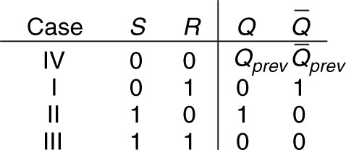
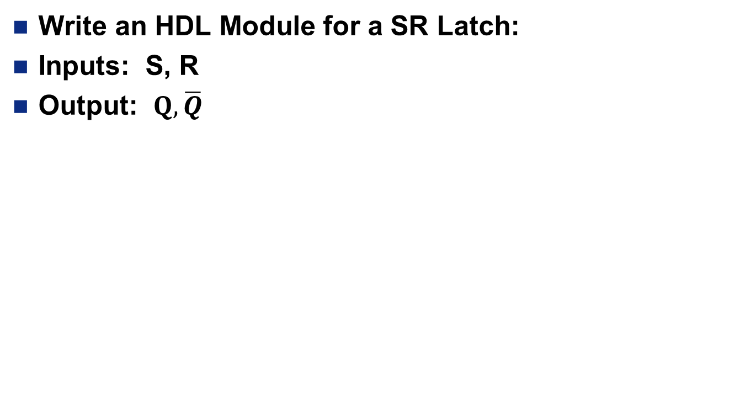
In Class Exercise #2:
Write an HDL Module for a SR Latch:
Inputs: S, R
Output: $Q, \overline{Q}$
Figure 3.5 SR latch truth table
Copyright © 2013 Elsevier Inc. All rights reserved.

Slide 20
Example Process
process(clk)
begin
if(rising_edge(clk)) then
if(reset='0') then
old_button <= "00000";
else
btnActivity <= (old_button xor btn) and btn;
end if;
old_button <= btn;
end if;
end process;

Slide 21
Extra Instruction (EI)
Maj Jeffrey Falkinburg
2E46E
Office: 333-9193
M1
ECE 281 – 2F44
T1
M2
ECE 281 – 2F44
T2
M3
ECE 463 – 2G2
T3
ECE 383 – 2E48A
M4
ECE 463 – 2G2
T4
ECE 383 – 2E48A
Available
M5
T5
Sometimes Available
M6
ECE 383 – 2E48A
T6
Always Unavailable
M7
ECE 383 – 2E48A
T7

Slide 22

22

